Slide 1
Capstone Project - The Battle of Neighborhoods (Week 2)
By
Smriti Sharma
August 03,2020

Slide 2
Contents
Business Problem
Data
Methodology
Results
Discussion
Conclusion

Slide 3
Business Problem
Being a stakeholder, if you want to open a grocery store in any city, your main concern is always about best location and also you will prefer a safe location so that you don’t have to suffer a loss. In this final project week 1, we aim to find a secure place or location to open a business in Vancouver city of British Columbia, Canada. Significantly, this information will be aimed for stakeholders or business person who is much interested in opening any retail store like Grocery store in the Vancouver City of British Columbia, Canada. In this chore, first thing would be find the safest borough by analyzing the data for crime for opening a grocery store and then filtering the neighborhood where the store is not between the most usual venues and yet it is very close in proximity to the city. For this purpose, we will use data science tools and packages to analyze the data and find out the secure borough and try to explore its neighborhood. Along with this, we will also try to find ten common venues for each neighborhood and see which is the most suitable neighborhood where grocery store can be opened.

Slide 4
Target
Target are the business people who are interested in opening a grocery store in the safest place in the neighborhood of Vancouver city
End audience are the customers

Slide 5
Data
As per the problem statement, the components that will be helpful for our decision making are:
Find safest borough as per crime data in Vancouver city
Find out the common venues
Selecting the best neighborhood
For this purpose, geographical location of Vancouver city will be used to find the neighborhoods around the borough which is safest and also near to city and in the end, will cluster neighborhoods. Below is the data which we will be using for our business problem:
Section 1: Will use Kraggle data set of Vancouver Crimes from 2003-2019 which has data related to type of crime, year, month and time.
Section 2: We will use Wikipedia to find the official boroughs in Vancouver city. This borough information will be utilized to map the data and neighborhood will be assigned to its borough.
Section 3: We will create new dataset which will have all these neighborhoods, borough, crime data and the geographical location of neighborhood. This location we can get from Geocoder to explore the neighborhood and can be used to plot on map. We can analyze using these data.
Section 4: We will create new dataset of neighborhoods, borough and common venues. We will use Four Square API for exploring the venues and then we will cluster the neighborhoods and plot in on map using folium.

Slide 6
Methodology
We will describe the methodology section in couple of parts:
Part 1 - Exploratory Data Analysis : In order to identify safest boroughs in Vancouver city , we will visualize the crimes and normalize the neighborhoods of boroughs respectively. We will find ten common venues in each neighborhood.
Part 2 - Modelling : To help the business person , we will cluster the neighborhood using K means clustering. We will use K-means clustering to provide the solution for this problem and help the decision making .

Slide 7
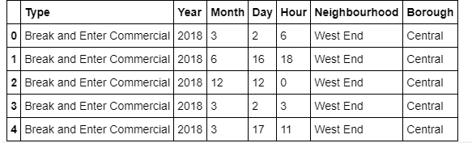
Execution

Slide 8
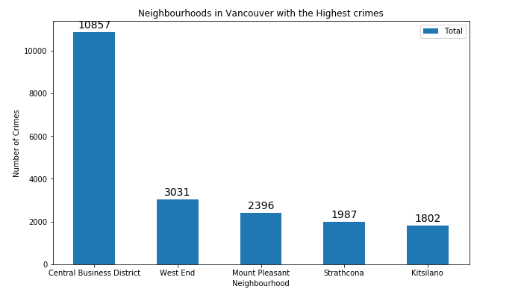
Execution

Slide 9
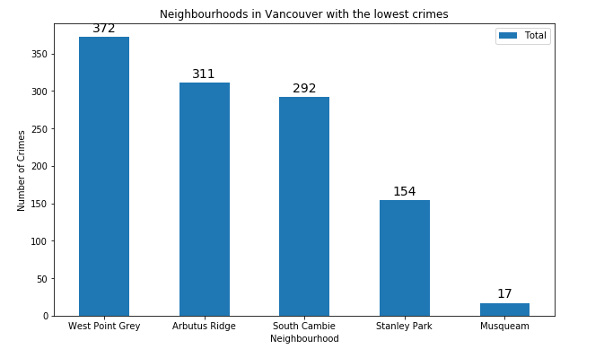
Execution

Slide 10
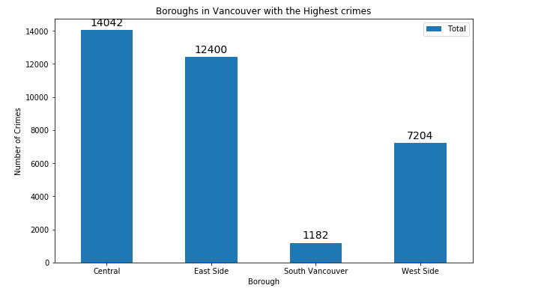
Execution

Slide 11
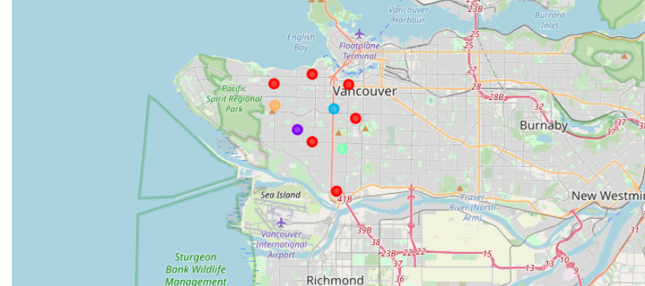
Execution

Slide 12
Results and Discussion
The main goal of the business problem was to find some safest neighborhood in Vancouver city of British Columbia for the stakeholder or businessperson so that they can open a grocery store in the neighborhood within the borough. We were able to achieve this by using various methodology like using crime data of Vancouver city to identify safe borough. After finding the safe borough , we wanted to select the best neighborhood where grocery store can be opened, and which is not close to other venues to each other. We achieved this by grouping the neighborhood into clusters and help businessperson to decide about venues and safety of neighborhood by showing them relevant data.

Slide 13
Conclusion
We explored the Vancouver city crime data with respect to all neighborhood and grouped them into their boroughs respectively. This helped us to find the safest neighborhood and further we were able to find the neighborhood based on the common venues to filter out the best neighborhood where grocery store can be opened by business person for end customers.

Slide 14
Thank you

